Slide 1
Household Water Monitor
Billing System
Java Group Project
Presented by: D. Vishruth Goud
B. Pavan Kumar
Faculty Guide: V. Gopi Krishna Sir

Slide 2
1. Introduction
1
Household Water Monitor Billing System is a console-based Java program.
It reads household water-meter readings and calculates water consumption.
The system generates a slab-based water bill.
It also classifies usage as Normal, Moderate, or High.
The program validates meter readings before calculating the bill.

Slide 3
2. Problem Statement
2
Manual water-bill calculation can lead to incorrect usage or billing values.
A household needs a simple way to calculate consumption from previous and current meter readings.
The system should apply different tariff rates to different usage slabs.
It should identify unusually high water consumption.
Invalid readings, where current reading is less than previous reading, must be rejected.

Slide 4
3. Objectives
3
Input: Collect household name, number of members, previous reading, and current reading.
Validation: Reject readings where current < previous.
Billing: Calculate the bill using three progressive tariff slabs.
Monitoring: Display Normal, Moderate, or High usage status.
Reporting: Generate a clear water-usage report for the household.

Slide 5
4. Existing System
4
Traditional/manual calculation of household water consumption.
Bill calculation may require separate manual steps for consumption and tariff slabs.
Usage monitoring is not automatically presented with the bill.
Manual input and calculation can increase the chance of arithmetic or reading errors.

Slide 6
5. Proposed System
5
A console-based Java application for household water billing.
Uses Scanner to collect meter and household information.
Calculates usage as current reading − previous reading.
Applies progressive three-slab billing.
Displays usage status and a complete water-usage report.
Stops with an invalid-reading message when the meter readings are inconsistent.

Slide 7
6. System Architecture
6
Input Layer → Scanner collects household and meter details.
Validation Layer → Checks whether usage is non-negative.
Processing Layer → Calculates water consumption and applies slab billing.
Monitoring Layer → Determines Normal / Moderate / High usage status.
Output Layer → Prints the final water usage report.
Input
↓
Read household + meter readings
↓
Usage = Current − Previous
↓
Valid?
├─ No → "Invalid meter readings!"
└─ Yes
↓
Progressive slab billing
↓
Usage status
↓
Water Usage Report

Slide 8
7. Functionalities
7
Household Input: Name and number of members.
Meter Input: Previous and current readings in litres.
Reading Validation: Current reading must not be lower than previous reading.
Consumption Calculation: Water used = current − previous.
Progressive Billing: Each tariff rate applies only to litres within its slab.
Usage Monitoring: Normal, Moderate, and High usage status.
Report Generation: Displays all household, meter, usage, status, and bill details.

Slide 9
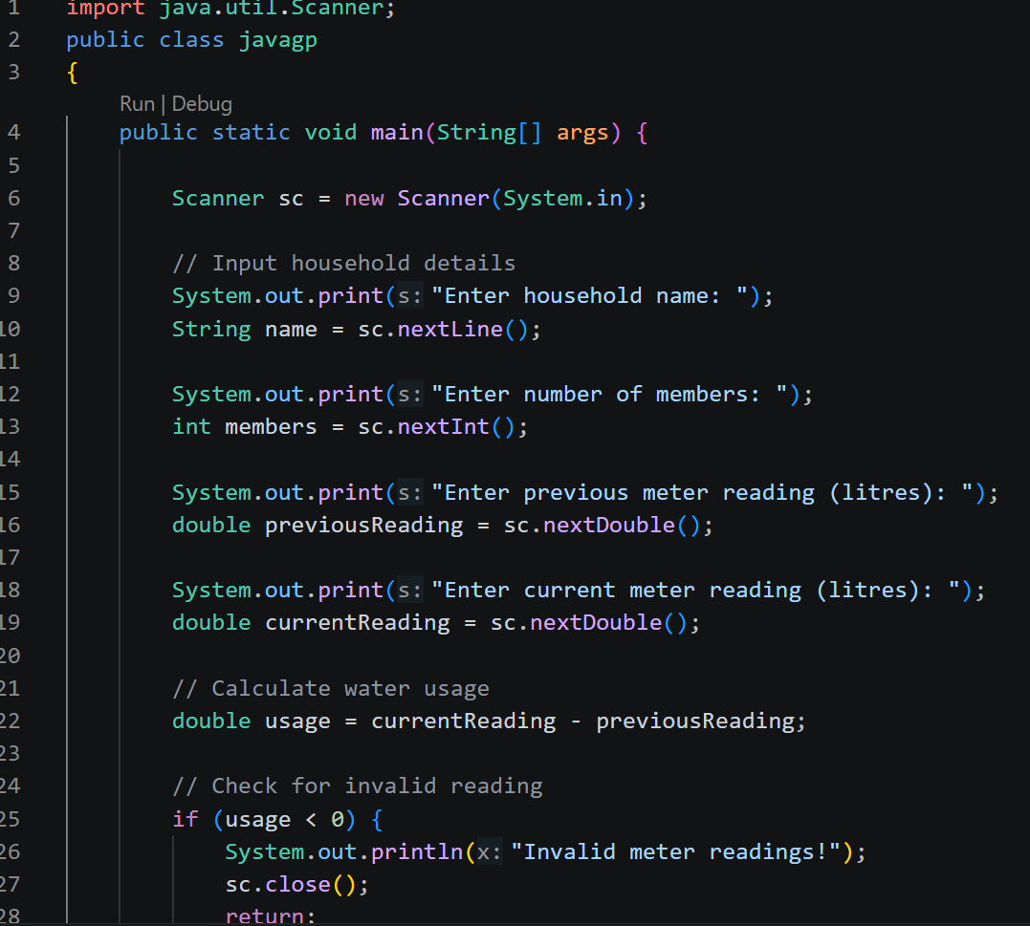
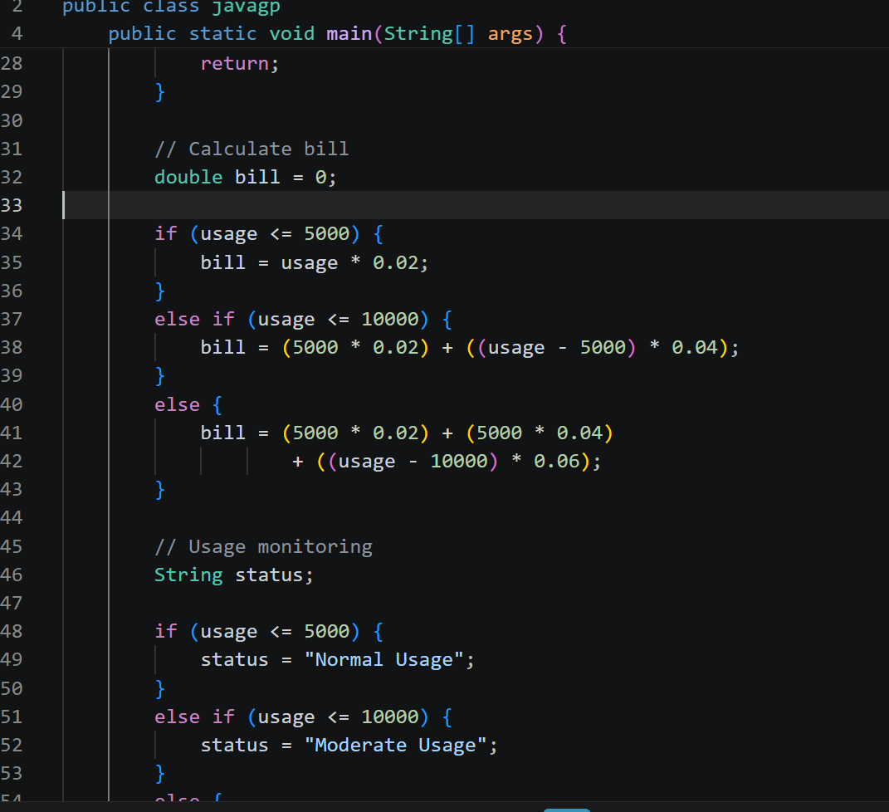
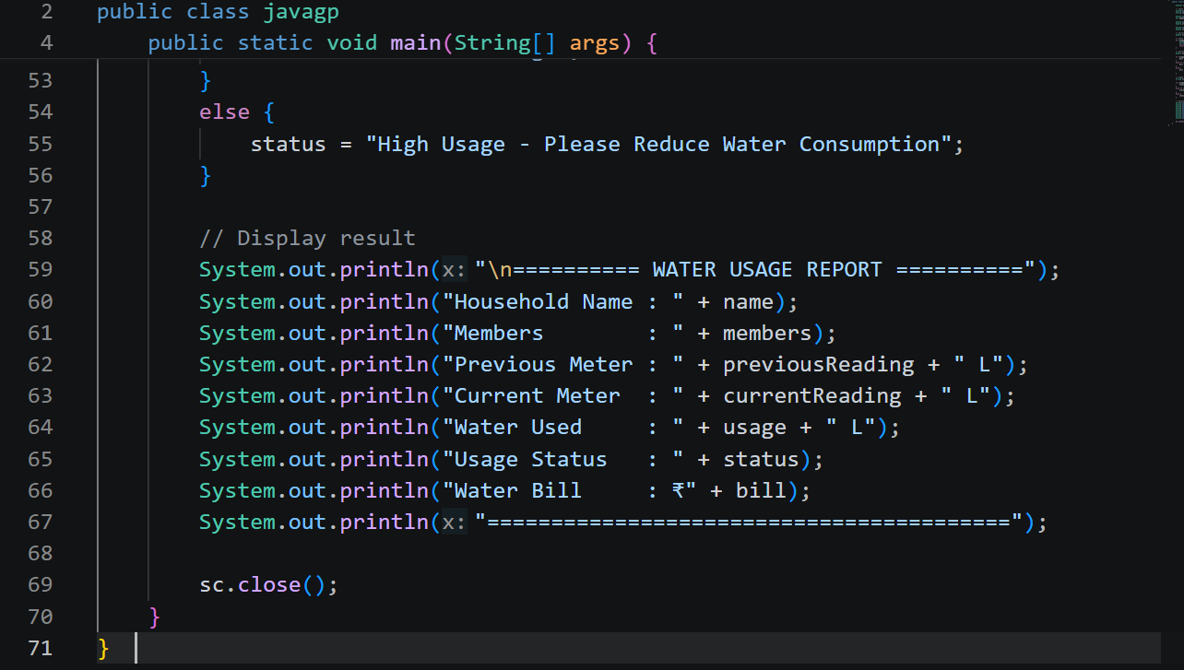
8. Implementation – Java Code Screenshots
8
Implementation is a console-based Java program using Scanner and conditional/slab-based billing logic.
Use the project’s Java source screenshots in this section if available.
The following core logic is represented by the existing project flow:

Slide 10
9. Output Screenshots
9
Enter household name: Sharma Family
Enter number of members: 4
Enter previous meter reading (litres): 12000
Enter current meter reading (litres): 20500
========== WATER USAGE REPORT ==========
Household Name : Sharma Family
Members : 4
Previous Meter : 12000.0 L
Current Meter : 20500.0 L
Water Used : 8500.0 L
Usage Status : Moderate Usage
Water Bill : ₹240.0
=========================================

Slide 11
10. Future Scope
10
Store records for many households.
Add per-member usage limits.
Develop a GUI version of the application.
Integrate the application with IoT smart-meter systems.

Slide 12
11. Conclusion
11
The system provides simple and accurate slab-based water billing.
Input validation helps prevent incorrect bills caused by invalid meter readings.
Usage status helps identify higher household water consumption.
The project provides a foundation for future multi-household, GUI, and smart-meter features.

Slide 13
Thank You
Household Water Monitor Billing System

